Slide 1
Ohemaah’s recent launches at

Slide 2
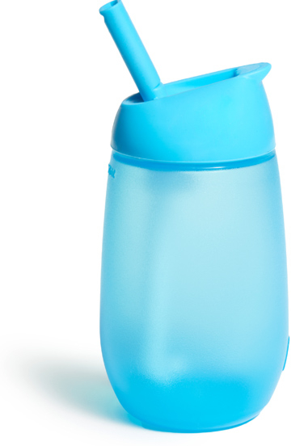
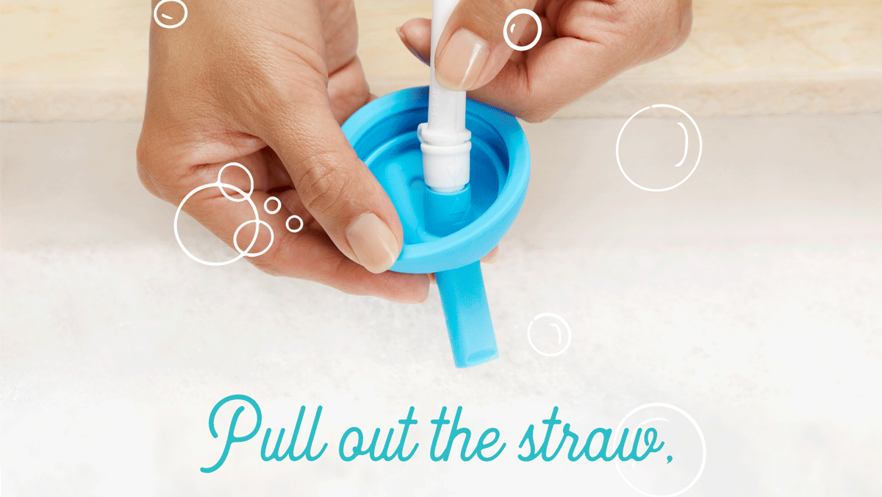
SIMPLE CLEAN™ STRAW CUP
Winning technology, innovative design
High velocity in retail!
Why it’s a hit:
Easy to clean straw with no additional details brush

Slide 3
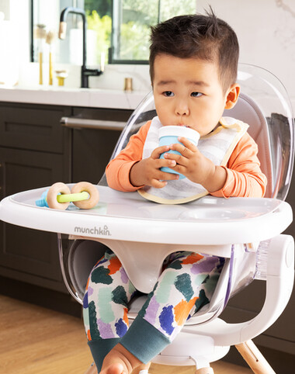
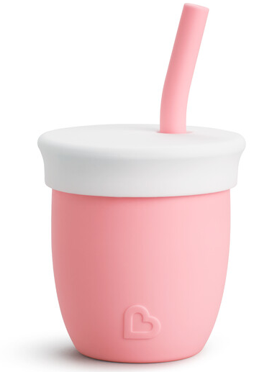
SOFT SIPPY’S IN STAGES
C’est Magnifique! C’est Silicone!™
Open
Straw
4m+
6m+
2oz
4oz
Notes:
They took the 4oz straw cup in mint for 2023 set; 1200 stores

Slide 4
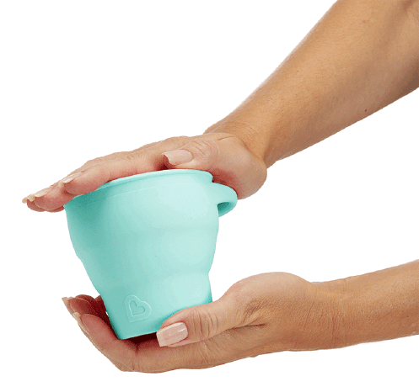
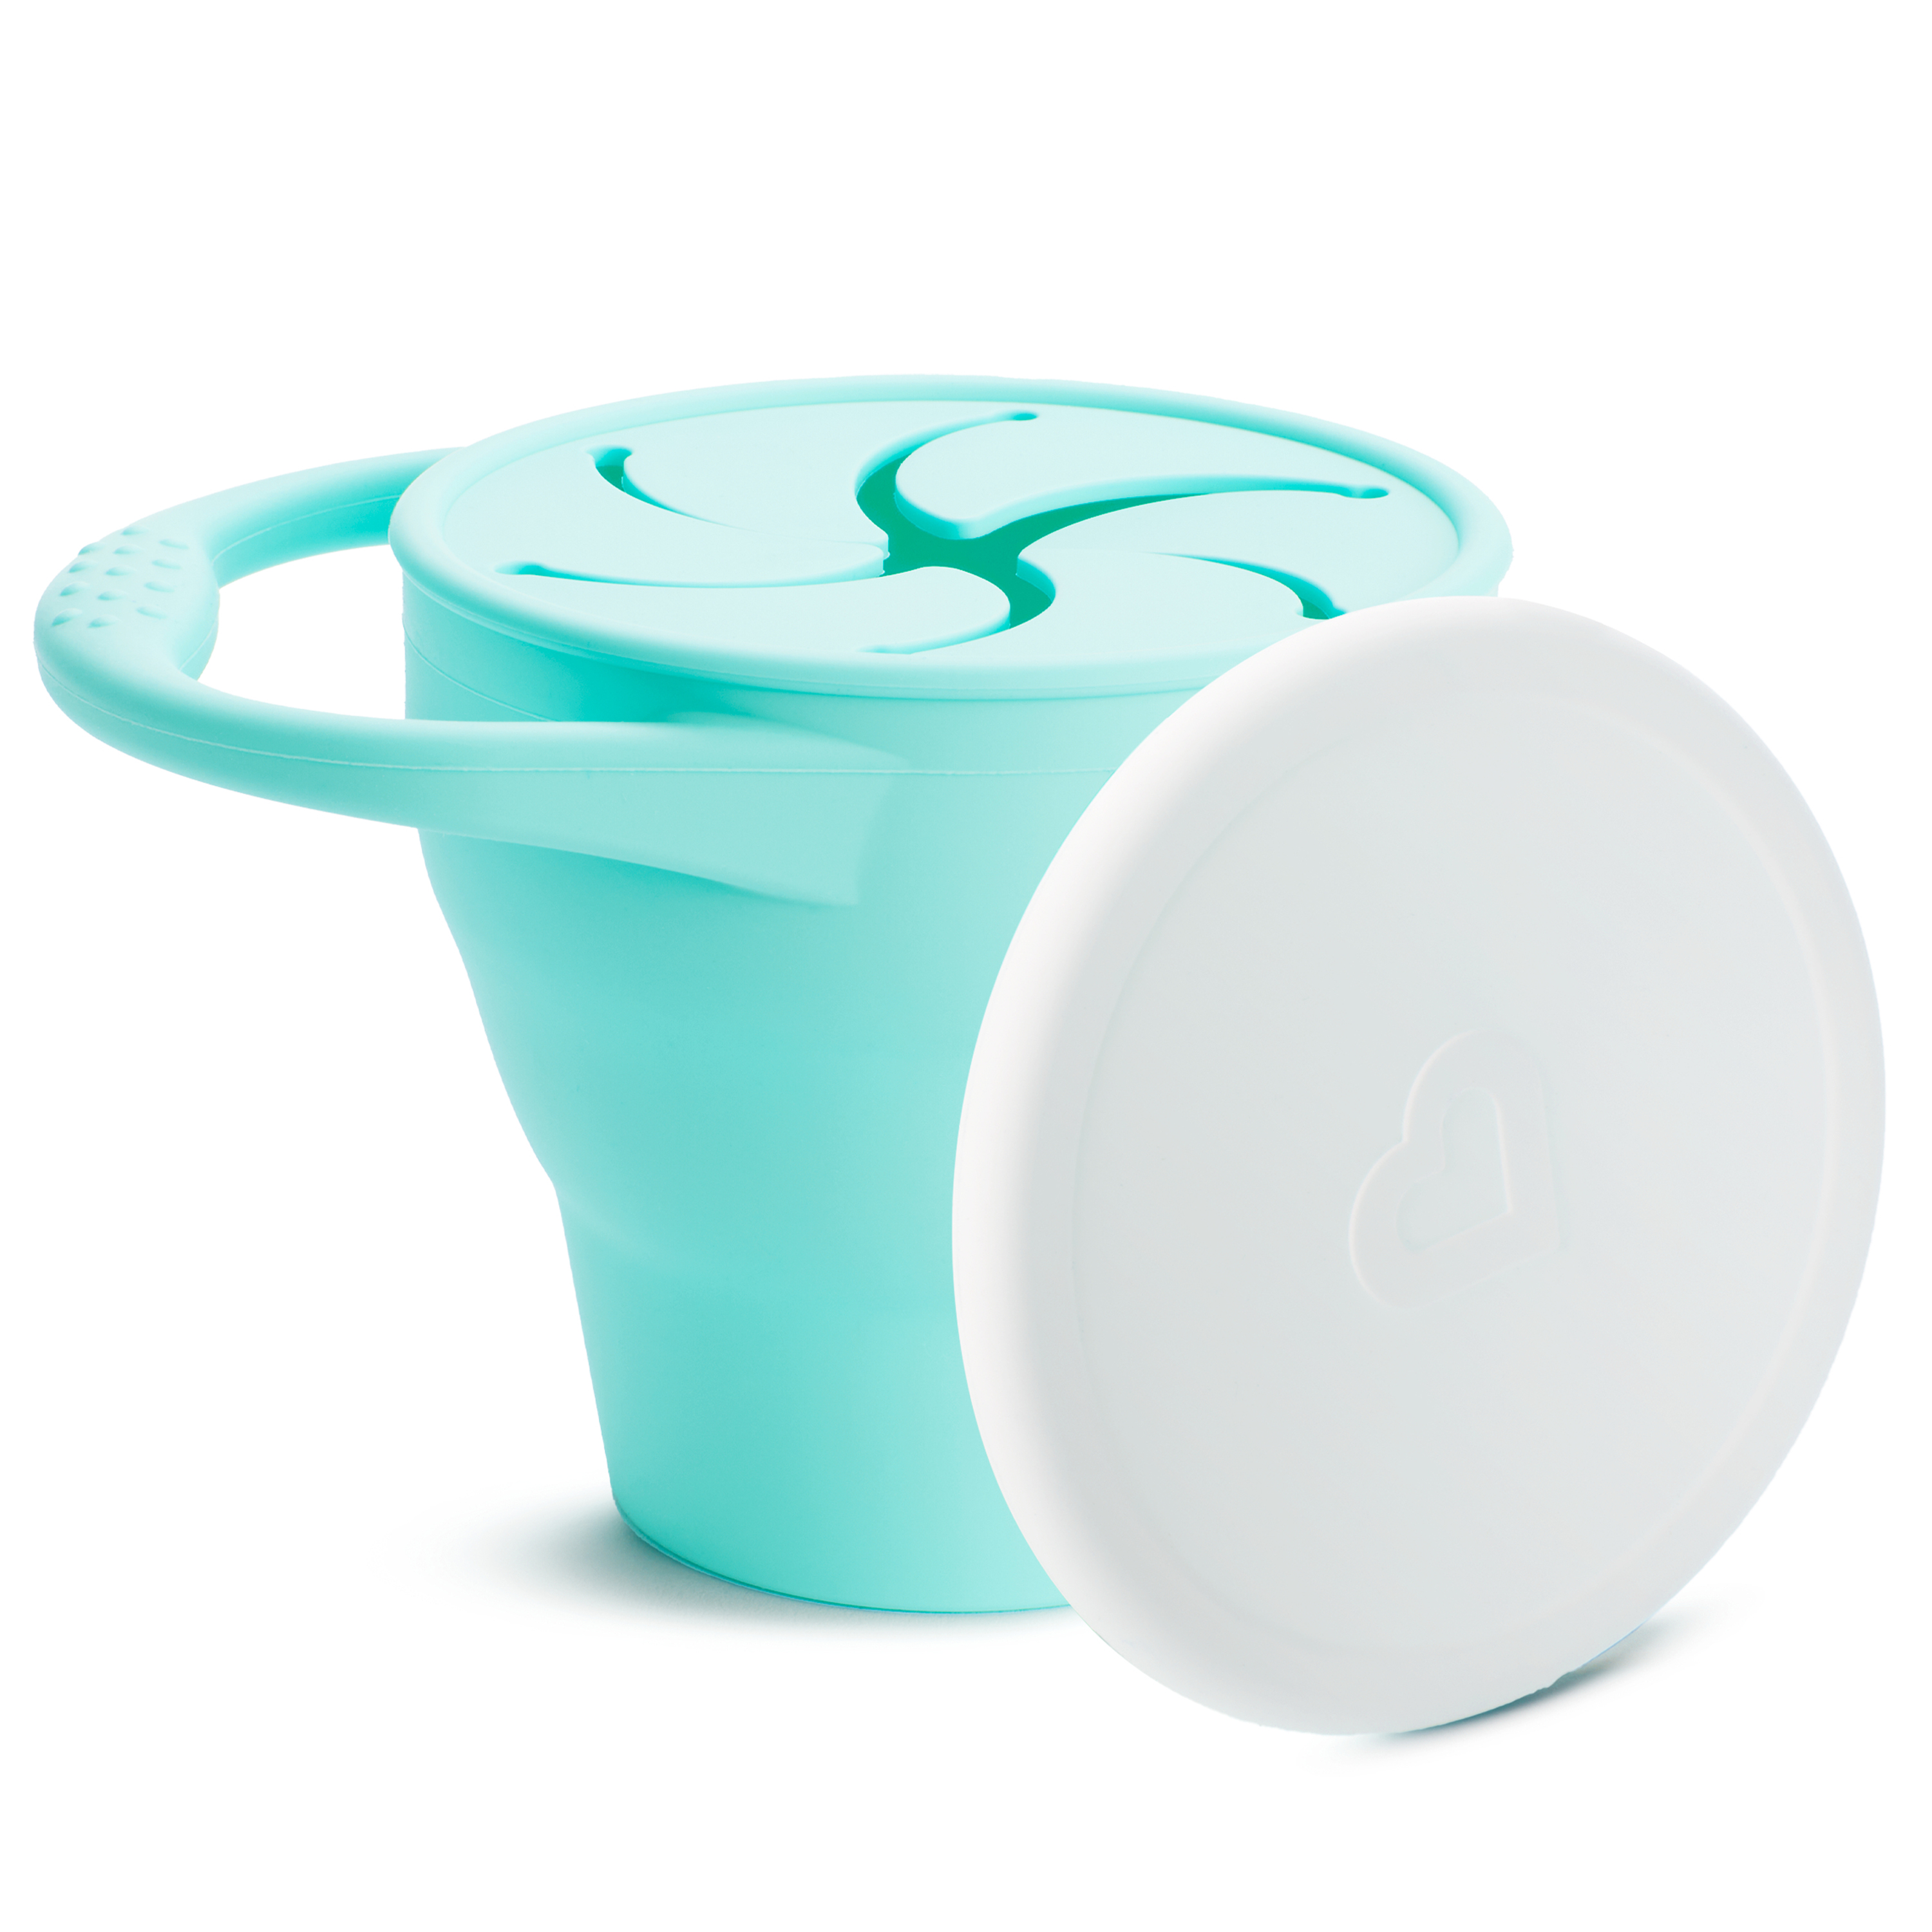
READY, SET, SNACK!
C’est Magnifique! C’est Silicone!™
Notes:
They took the 4oz straw cup in mint for 2023 set; 1200 stores

Slide 5
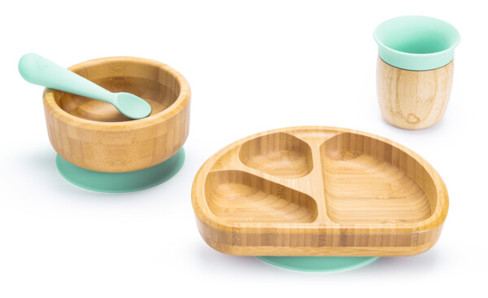
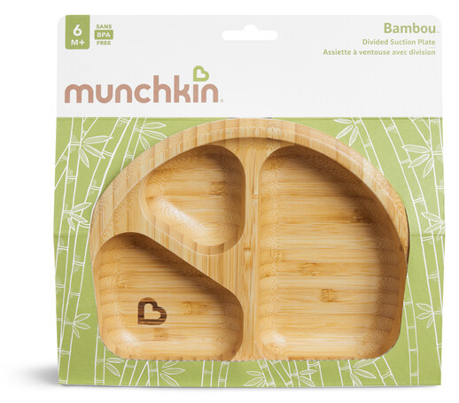
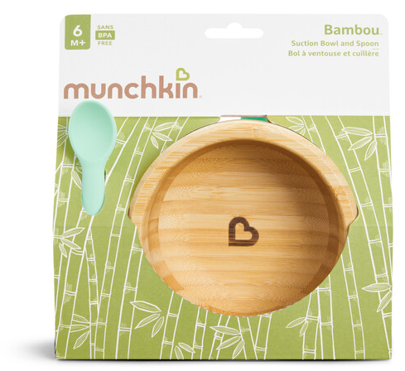
SUITE SUSTAINABILITY!
BAMBOU™ Mealtime Suite

Slide 6
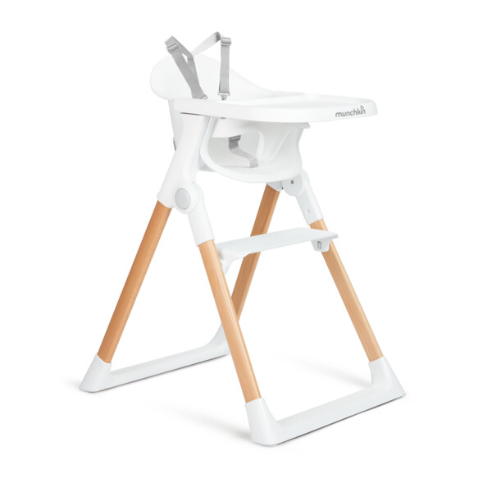
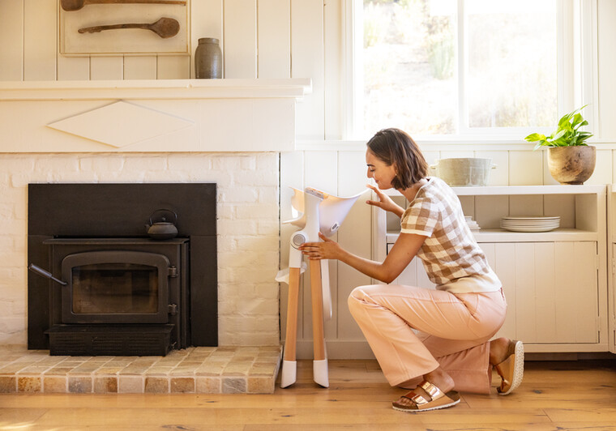
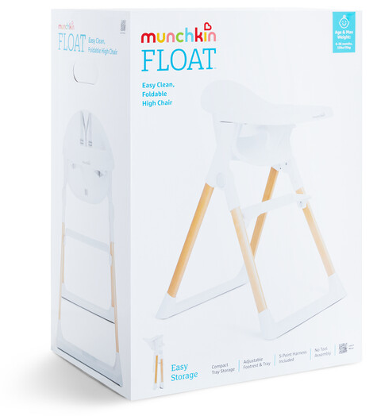
FLOAT
Light as a feather.

