Slide 1

BFY Claim Strategy Recommendations
Ohemaah Ntiamoah
July 20, 2015
1

Slide 2
Agenda
[“Oh Yeah!”]
The Consumer & Motivators to Purchase
The Non-Consumer & Barriers to Purchase
KA Portfolio Claims Assessment
Recommendations & What’s In It for Us
Implementation & Next Steps
Project Scope
To develop an overarching BFY claim strategy to convey a unified message to our consumer, and lay out the implementation of such a strategy
Notes:
Speak on what I was asked to do (the bullets) consider the LOGO “OH YEAH”
consolidate - 3 or 4 big things
PROJECT: Kool Aid Portfolio Overarching BFY Claim Strategy
Provide an analysis of key barriers to purchase
Assess key product claims across portfolio
Identify opportunities to create an overarching claim(s) for entire portfolio
Lay out financial implications, hurdles, and next steps
Should include proj obj

Slide 3
Executive Summary
Health & Wellness is a growing concern of our core and SVC consumer.
4 in 10 US consumers agree they pay attention to the types of sugar and sweeteners used in juices and CSD’s…” –Mintel.com, Annual Overview – Nutrition, Health & Wellness 2015
Today our portfolio is not positioned well to address barriers which center around H&W concerns.
Current KA product claims varies across forms and claim type (sugar, antioxidants, Vitamin C, etc)
We need a unified BFY claim strategy portfolio-wide: 50% less sugar and a Good Source of Vitamin C.
Implementing this will position us to re-gain share and advertise more KA forms to children.
Leverage synergies from Jammers Renov., Mio fortification, and Project Seneca
80% of panelists ranked these as their top two RTBs in 2014 Affinova
Estimated total investment: approx. $0.9MM to communicate a new message on RKA, reformulate 32oz. and 96oz. RTD bottles, and fortify Bursts and LC
Difficult to position brand as a better-for-you option to consumer
3
Notes:
Increase font size on the big ones
enable us to effectively advertise a clear message, address barriers, and increase HH penetration (1pt = $32.34)

Slide 4
Core Consumer & Motivators to Purchase
4

Slide 5
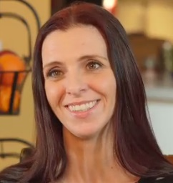
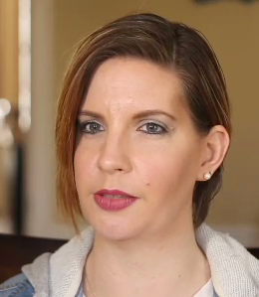
Kid request and nutritional value are important to our core consumer and SVC
Friend Mom
Coach Mom V1
“The drinks I buy need to be appropriate for a variety of occasions, to pack in lunch boxes or for after school activities.”
“I pretty much get what [drink] I know they’ll love. I look for things that are ‘in the middle’ – not too bad for them.”
“I look for new flavors that my kids think are “cool”, but they still need to be nutritional and contain vitamins.”
Non-Soda beverages are one of the more permissible categories.
If it’s a less acceptable choice, Mom will limit frequency of usage.
*Source: KA Consumer Team Engagement Learnings 6/9/14
*Source: KSSB Mom Segments & New Moms, 2013
Notes:
-Our consumers are motivated by kid request and nutritional value.
-We cater to the friend mom and have an opportunity with these changes to grow with the coach mom. Taste is king to both types of moms, and they’re motivated by whether or not they think the kids will like the beverage and also want to make sure it’s not bad for them.
-Increasingly, nutritional content has become important to our core consumer.
-So we’re taking action to make sure we deliver on that front to our growth opportunity consumer while not alienating our core.
Friend mom is our strategic value consumer actually
Not alienate core but opportunity to attract new
point out that we’re making these changes because we’re trying to grow with Coach Mom but
POINT out that my strategy will continue to talk to current consumers and will not alienate our core.
Speaking point: KA is remaining flat in the KSSB category (competitors that grew in share YTD include Apple & Eve, Horizon, Hawaiian Punch, Little Hug, Honest Kids), and we’re losing share in the powders business to competitors such as 4C, Gatorade, Propel
Every slide should be a set-up for what I’m going to present later. Sell how bad the problem is; our Kool Aid mom – is she leaving the brand and not being replaced by any new users? Barriers? HH penetration data? Share decline? Who’s gaining the share that we’re losing?
The actual main bullseye for us is Friend Mom.

Slide 6
Non-Consumers & Barriers to Purchase
6

Slide 7
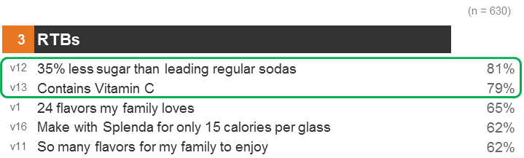
Non-consumers rank “too sweet” and “not nutritious” as their top barriers, and are looking for less sugar & Vitamin C claims
106 Non-Purchasing Moms in past 6 months (Q. 15 Barriers ranked by moms)
 | Ranked 1st
Is too sweet
Is not nutritious
Contains added sugar
Contains artificial flavors
IS not ‘all natural’
Contains artificial colors
It’s not on sale or promotion
Is not appealing to child(ren)/kids
Is not liked by everyone in the house
I need to have sugar in my home to prepare it
Is not appealing to adults
Is not available at convenient locations
Is not good for school lunches
Is not hydrating
Is not low calorie
Contains high fructose corn syrup
Does not have electrolytes
Is not a good value
Is not good on-the-go
Creates a lot of bottles or empty cans to discard
Is not a drink where I can control the amount of sugar
Contains artificial sweeteners
Is not something that makes me happy
*Source: Radius barriers opportunity study, 2014
Non-consumer “ask”: less sugar, Vitamin C
*Source: excerpt from Affinova on Claims, Apr. 2014
Notes:
-We did a Radius study last year to identify barriers to purchase, and I sifted out the data to focus on the top-ranked barriers of moms with kids ages 6-12. Their top-ranked barriers to Kool Aid are that it’s too sweet and not nutritious
-An Affinova we did that same year echoed these sentiments. About 80% of non-consumers made choices that had less sugar and vitamin C – that is essentially what our non-purchasers are asking for: less sugar and Vitamin C are the most compelling reasons to believe.
More people (roughly 80%) made choices that had these two attributes in them than any other attributes
Point out: Consistency throughout the 2 studies (Affinova and Radius)
“Outside the context of the holistic concept, consumers indicate strong interest in the 35% less sugar and Vitamin C RTBs which are present in all three Top Concepts, indicating strong consumer reassurance and acceptance of these RTBs.”

Slide 8
KA Portfolio Claims Assessment:
Where Do We Stand?
8

Slide 9
Current portfolio claims vary by form and need consolidation for effective communication
Sugar
Claims
-SSKA (35% less… soda)
-Singles (50% less than regular KA)
-Bursts (75% less…soda)
-Wacky Waters (80% less...soda) but no current claim
Vitamin C Claims
-Jammers (100% DV except 3 SKUs: just “Vitamin C”)
-16, 32, & 96oz RTD (100% DV)
-Powders - “Good Source” currently
(past: “Provides”, “Rich In”, “Excellent Source” depending on SKU)
-Easy Mix (50% less…soda) ~ only made in ads, not on pack
Other KA Claims Over the Yrs:
-Antioxidants
-Strategic Ingredients (Juice Content claims)
-Vit. E
-Gluten Free
-With Other Natural Flavors
Notes:
Within these two claims groups we’re very cluttered
Some of these claims are no longer applicable but we’ve made them

Slide 10
We can have one unified message across Kool Aid forms without alienating consumers
*Dollar share of product within segment index vs. avg.
Index over 120
Index 100-120
Index <80
*Source: KA Jammers Renovation Update, 6/3/15
Notes:
---So demographically speaking, we can make claims across forms and talk to the consumer about KA as a whole without necessarily alienating one type of consumer
They care about BFY and we can talk about them the same way across each of the different forms.
POINT out that my strategy will continue to talk to current consumers and will not alienate our core.
Former title: KA usage by form shows that demographically across the different forms, the consumer looks the same. Therefore we can achieve efficiency through a unified message
Consider combining slides 7 and 8
The bottom is the main point here. Speak to the top one.
Possible question:
Rebuttal: the forms are differentiated and rather highly incremental to each other. Actually about 78% of purchasers are form exclusive
We over-index cross-form among families and under-index in millenials, established couples, and singles adults.
Remember to point out the axes when talking about the slide

Slide 11
Recommendations
11

Slide 12
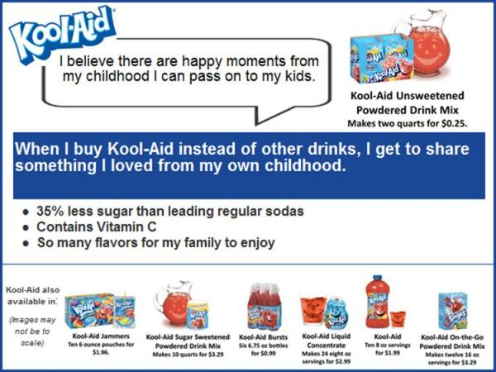
A Less Sugar/Contains Vitamin C Kool Aid claim positioning outperformed the majority of the tested competition in Affinova re-stager
TC 2 (Childhood Memories)
“Restages focusing on sugar control (TC 1 & POC Sugar Control) and nostalgia (TC 2) provide a significant lift in preference over current (~54% increase) and other restages.”
“Additionally, the winning restages outperform the majority of tested competition, notably Hawaiian Punch, Capri Sun, Sprite and Arizona which the current falls below.”
~54% lift over Current
B
TC 2 (Childhood Memories)
CF
4.0
F
Current Kool-Aid
2.6
CONSUMER PREFERENCE SHARE
Current Kool-Aid
Hawaiian Punch
Little Hugs
Great Value
Crush
Capri Sun
Sprite
AriZona
Minute Maid
V8
*Source: Affinova, 2014
Notes:
Question of: what’s the trade-off (what if we only made a 35% less…
SPEAK TO the fact that there’s no way of knowing what increm. Sales this strategy will produce.
The lift comes from the communication of it, the idea of it. Not from the taste.
Combine this with

Slide 13
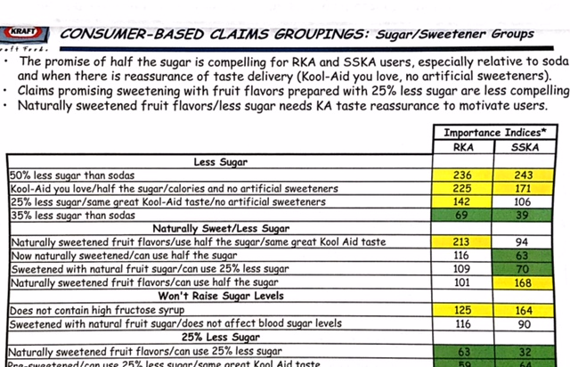
For “Less Sugar” claims, the greater the reduction, the more compelling the message
*Source: Kool Aid Claims Optimization Study, 2007

Slide 14
“50% less sugar than soda and a Good Source of Vit. C” is the best, most feasible claim strategy to meet consumer needs
A 50% less sugar claim is the most compelling reduced sugar claim to our consumer
  Claims Optimization Study, 2007
  Consumer Engagement research
  Affinova, 2014
Vitamin C is the enhancer that our consumer wants
  As opposed to alternatives like calorie reduction, antioxidants, Vitamin A, E, D, and electrolytes
  Over-indexed by 300% to 600% among RKA and SSKA users (see Appendix)
We will make sure all KA forms meet or exceed these standards
Notes:
Link the % sugar recommendation better (how you got to it – right now it seems to come out of nowhere)
-we’ve done a lot of work and determined that a less sugar claim is what moms are looking for
-50% less sugar needs to be led up to
Mention how we need to keep in mind that taste is king and -> won’t be ignored….consumer taste testing
Simplify this.
Question may come up about how old this study is.
Rebuttal: just did recent Affinova that confirms

Slide 15
What’s In It For Us?
15

Slide 16
The new strategy should increase consumer purchase intent and generate higher ROI by advertising more forms to children
Address consumer barriers
  1 HH penetration point => $32.34 of revenue
Consumer purchase intent => 54% lift
A&C payback
 | 2015
 | Digital | TV | Search
 | PB | PB | PB | Total
Payback | 78% | 78% | 10% | 76%
 | 2016
 | Kids TV | Kids Digital | Mom Digital | Mom Print | Search | IMC
 | RTD | RTD | PB | PB | PB | RTD | Total
Payback | 110% | 110% | 50% | 85% | 10% | 50% | 81%
*Source: ZBB Template Spreadsheet Round 2v2
Notes:
“Payback” here means: how much that mode of advertising paid off in terms of operating income
In the implementation section show what it will take to get total TM to -> kid adv.
Our current under-performance may be because we’re relying on halo. Right now we don’t have clear linkage between the product being shown and what form we expect/want them to buy.
Kids’ TV is a lot cheaper than mom’s TV and therefore a lot more efficient
Easy Mix, Singles, and LC are the only products in the KA line that we advertise to children at this point in time.
RKA will be 15 calories and 15 mg of sodium under my recommendation
SSKA is currently 60 calories; 0 sodium. With Proj. Seneca it will still fall short by 10 calories
RTD bottles are 150 cals, 45mg sodium. They should meet the calorie requirement under Jammers new formula; sodium???
Bursts currently have too much sodium which will not change from fortification
Jammers currently has 15 calories and 25 mg of sodium. Jammers Renovation will make these qualify for advertising to kids. Therefore
Wacky Waters already qualifies for advertising to kids; just hasn’t been pledged for that yet. Looking to launch in 2016
Easy Mix has 40 calories and 0 sodium (currently being advertised to children)

Slide 17
Implementation
17

Slide 18



RTD Bottles, Bursts, LC, and RKA need work in order to make these claims
KA Product | Substantiation for % Less Sugar Claim | Sugar Claim Leveraged ? | Reference Found | Vit. C Claim? | Graphics on Pack for Sugar Claim? | Comments | CFBAI Complaint?/Will Be with recommendation?
Sugar-Sweetened Drink Mix |  | 35% Less Sugar than LRS | 5 Market Leaders Reg. Sodas |  | Yes | Undergoing Project Seneca -> will qualify for sugar claim if 2013 flavor enhancer formula is used as planned | No (needs 10 fewer cals after Proj. Seneca)
Bursts |  | 75% Less Sugar than LRS | Same |  | Yes | Currently does not meet Vit. C claim requirements. Cherry Bursts also hi in sodium | No (too much sodium)
Easy Mix |  | 50% Less Sugar than LRS | Same |  | No |  | Yes
Hybrid Singles |  | 50% Less Sugar than Regular Kool-Aid | Kool-Aid Sugar Sweet’d Drink Mix |  | Yes |  | Yes
Sugar Free Singles |  | NA | NA |  | NA | 0-5 calories per serving: 100% reduction in sugar. | Yes
LC |  | NA | NA |  | NA | 0 calories per serving: 100% reduction in sugar. | Yes
Jammers |  | NA | NA | (100%) | NA | Undergoing Jammers Renovation project -> will qualify under new formula | No (yes after Renovation)
16, 32, 96 oz. |  | NA | NA | (100%) | NA | Currently does not meet sugar claim requirements | Yes after reform (lower calories)
RKA |  | NA | NA |  | NA | Currently does not meet sugar claim requirements | Further discuss with Legal
Notes:
Don’t spend toooo much time on this slide.
These are the 4 we need to work on. Let me talk you through RKA first because we’re not making any formulaic changes but that’s the one that will require the most consideration.
Call out the RKA issue and point out that this is one option that we’ve considered with Legal. Make RKA the last line in this table and separate it out.
Point out how we may want to think of the fact that it may not make sense to try and treat RKA the same way we treat these other forms
Bold the Headers
Renee Franco is sales on RTD.
Easy Mix, Singles, and LC are the only products in the KA line that we advertise to children at this point in time.
RKA will be 15 calories and 15 mg of sodium under my recommendation
SSKA is currently 60 calories; 0 sodium. With Proj. Seneca it will still fall short by 10 calories
RTD bottles are 150 cals, 45mg sodium. They should meet the calorie requirement under Jammers new formula; sodium???
Bursts currently have too much sodium which will not change from fortification
Jammers currently has 15 calories and 25 mg of sodium. Jammers Renovation will make these qualify for advertising to kids. Therefore
Wacky Waters already qualifies for advertising to kids; just hasn’t been pledged for that yet. Looking to launch in 2016
Easy Mix has 40 calories and 0 sodium (currently being advertised to children)
Bursts fortification costly – fortification would be costly and it’s already a low-margin product; consider price increase
elasticities as well
counter: leverage savings from Vit. C reduction and reallocate that to help offset the cost
Bursts margins (Jamie) Costs: Joe
Talk to Melanie Graff about Mio LC research on benefits of adding Vitamin C. Or Missy Pydo [done]
SSKA Project Seneca- Based on the previous flavor enhancer formula used in 2013, it qualified for "50% less sugar than leading regular sodas". Plan is to use same formulas, but need evaluation to confirm % reduction.
KA Jammers Reform (low cal) will most likely qualify for "50% less sugar than leading Regular Sodas" . Will do initial assessment on HUT formulas next week
Bottles: FDA regulations require at least a 25% reduction in sugar vs. a reference food to make the claim. These products are 150 cal/serving which are very close in calorie level as regular sodas, therefore would not meet the claim requirements.
Unsweetened RKA: 100 calories per serving when prepared with sugar. (Primary prep). Only ~7% reduction in sugar vs. regular soda.

Slide 19

RKA: Switch primary and secondary prep instructions of RKA & call out change with clear messaging on front of package
Only Form-Specific
Advertising on RKA for now!
CONTENT:
25g vs. 3g sugar
CLARITY:
-No equity advertising at first. Educate consumer
-Facts Up Front
CONSENSUS:
Legal & NAR – difficulty making umbrella sugar claim that includes RKA; better if communication is form-specific
RISKS:
-scrutiny from CSPI
MITIGATION:
-communication & messaging
TESTING:
-BASES re-stager
-Consumer taste reassurance
Total Est. Cost:
-Packaging & Consumer testing
=
$267,000
*RKA is our legacy product and the most difficult to bring into alignment with claims due to consumer usage behavior. Additional thought should be given to including RKA in portfolio claims vs. separate treatment*
Notes:
Point out the key follow-ups and TASTE reasons and LEGAL reasons
RKA is made of salt, corn starch, and citric acid. Tropical Punch has only 2 more ingredients
Former bottom takeaway point:
Although we cannot control how consumers will/will not adhere to preparation instructions, we can actively communicate a better-for-you commitment
Sales opportunity – cross-promotion with Splenda!! E.g. tear-off coupon for Splenda
I’m aligned here. Would need to begin seeding the new consumer behavior to make RKA with a no-calorie sweetener before feeling good about equity advertising claiming 50% less. -Caroline Krajewski
do some advertising work over a year or two educating our consumers to make it with stevia and then make that kind of claim. But I don’t think we could make it right off the bat, for the reasons we discussed.
The cost to implement is about 0.2% of our business
Make it abundantly clear on how this must be communicated/advertised.
Just to change the packaging (just back): couple hundred bucks at best for the design by SGS to the prep instructions. SGS does small changes. But if you’re adding something to the front it could involve changing other things, so we may have to consult with SoulSite.
For the Separations Process: Low-end: $5,000/SKU; High-end: $10,000/SKU figure out how many sku’s there are of RKA and multiply it out
To put something on the front is probably a job for Soul-Site: ballpark ~ a few thousand dollars/SKU
Same for RTD graphics (changing to Good Source): couple hundred for SGS; 5-10k ballpark typical figure used for Separation Process
For example, for line extensions we budget from 30-60k for graphics the Separations piece is the most expensive
Talk to Whitney about impact of this on Sales and distribution
Graphics and printing expenses – get from A&C budget (Nicole and Devin)
Basket analysis and Ipsos study results reveal that Moms who purchase Kool-Aid also purchase ___________
Talk to Sales and packaging (ops??) about how feasible/costly; shelf space and how this would go over with customers and affect our TDPs
Mitigation of Risk: call it out on front of package (Facts Up Front program) and begin clear messaging encouraging lower consumption of sugar by trying these alternatives
We’d need to further discuss with ops and supply chain as well
Is there a better low-calorie sweetener we should consider, like Stevia? Is anyone even using the Splenda prep?
It might be worth making an investment behind the RKA line
For the “Facts Up Front” program (reflects the nutrition facts panel) and how it has to be as prepared; that’s when we started providing the calorie information on the back. I propose we make this change to the instructions while continuing our legacy of being truthful to our consumers – call out the new message up front so there’s no confusion of what we’re now encouraging our consumer to do that will make this better for them.
We may want to confirm how most consumers prepare it currently (i.e. what is the spread? And do people add more sugar than we recommend?)
Find out costs to implement
NAR doesn’t really have specific set-in-stone guidelines on prep instructions (spoke with Andrea Justo about this)

Slide 20
32oz & 96oz: Leverage Jammers formula and reduce Vitamin C levels
*Based on 2016 July IBP volume forecast | Savings from sugars in new Jammers Formula | Savings from Vitamin C | Total Est. Savings from formula changes
32 & 96oz | $0.007/lb | $0.00714 per 10% per bottle
Totals | $462,283 | $980,561 if we reduce to 10% level | $1,442,844
16 oz. is meant for a different consumer. No need to reform or adv. That size to kids
Total Est. Cost to implement: $ (1,372,344)
% Reduction of Vitamin C
*Source: R&D, based on Tropical Punch flavor raw materials costs provided by Supply Chain & Procurement
Notes:
Really articulate why we’re reducing Vitamin C level – think about PURPOSE and MARGINAL BENEFIT vs. cost; the marginal benefit of having higher levels? We’re not seen as the source of vitamin C for the consumer – we’re trying to be part of an overall healthy diet, not the sole source of vitamin C
SAY: Reformulate 32, and 96 oz. bottles using new Jammers formula; reduce Vitamin C level while remaining a “Good Source”
Reallocate cost savings to finance other portions of this recommendation
Kool Aid bottle R2D is made by an external manufacturer (COTT) – so we would have to take their costs into consideration as far as any reform’s
Costs to Implement:
None for reformulation itself
Cost savings actually
$200,000 one time for re-labeling with “Good Source”
We don’t think that this reformulation will add anything to our revenue for bottles. Jamie and Jason worked on this and reached that conclusion; it’s only a $13MM business and pretty much only available in WM. This isn’t going to generate any lift or anything like that.
if you took the Jammers formula and put it in a 16oz bottle that is 1 serving, can you meet the 50% less sugar claim? Talk to Andrea Justo. Answer: yes.
how the serving sizes might interfere (e.g. Chia bottle -> too many calories). HOW DOES IT COMPARE TO THE FORMULA CURRENTLY IN THE BOTTLE? PUT THE THREE SIDE BY SIDE IN APPENDIX SHOWING WHAT YOU’D BE CHANGING
**By reducing the sugar profile it actually improves the cost profile of the product.**
Removal of Vitamin C Savings $_______ / lb across the entire line
Hybrid Sweetener savings of $0.0058 / lb in 96oz and 32oz
If we reformulate the hot-fill bottles, we could borrow new formula elements from new Jammers (which will qualify) but may need some tweaks to suit bottle form (only applicable to 32 and 96 fl oz. 16 is a whole different set of requirements)
*Keep in mind, the 16 oz. was meant for a different consumer base altogether. If any formula changes are going to be made to the 16 oz. we will have to do additional consumer testing to make sure we don’t alienate that user base – then again, that would probably be a larger question of cost vs. ROI considering we are currently losing money on this particular product anyway (16 oz. profit margin is -8.6% of GR)

Slide 21
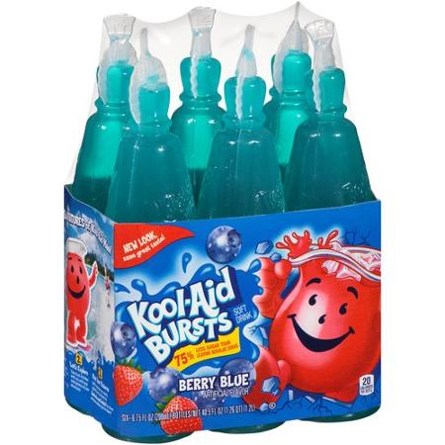
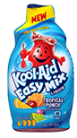

Bursts & LC: Fortify both with 10% Vitamin C to meet “Good Source” requirement
Fortify with enough Vit. C to meet 10% at end of shelf life
  Total Est. Costs:
  One-Time Costs: $100,500 (packaging, consumer testing)
  Ongoing P&L impact: 0.5% increase in raw materials (in 2016: ~$0.000918/lb. produced)
  Margins Before and After: 21.2% -> 21.2%
  *source: Jamie Daugherty (Finance)
Leverage Mio fortification project insights
  R&D currently testing shelf life and degradation, all flavors
  Packaging more costly than other KA forms
  Total Est. Costs:
  One-Time Costs, Super LC: $99,500
  One-Time Costs, Aladdin: $61,500
  Ongoing P&L impact: 0.5% increase in raw materials
  Margins before and after: 69.44% -> 69.39%
  *source: Mattie Terry (Finance)
Notes:
These are gross margins
Why is the 0.5% not reflected? Because in order to get to the margin percentage it takes into account a lot of different variables (Raw, VL&E, D&T, etc) so 0.5% of one variable is not going to impact the sum of those variables’ percentage form.
ACKNOWLEDGE THAT BURSTS
RKA MC % of NR: 67.83%
KA LC MC% of NR: 69.44%
Margin after recommended changes
RKA MC % of NR: No impact
KA LC MC% of NR: 69.39%
What’s the return here on this type of investment for LC?
What % increase on volume would we have to see to break even on this?
Do the calculations . Question with LC – LC category is declining. Justification? Know the numbers
LC sales reco: marry timing with Mio to make it easier to harmonize, collapse time frames and have ONE conversation with customer. We often look like we trip over ourselves with our brands. Synthesize. FIND OUT DEEPA
Bursts Packaging:
-we’d have to re-design both the singles and the packs. Same estimates of couple hundred from SGS (use a median of $500 but we’d have to get estimates); 5-10k for Bursts
-LC separation costs are typically higher (probably closer to 8-10k)
Costs per bottle for LC (coming from Mattie) all LC is bottled externally -> manufacturing costs (VL&E)
Look into LC costs of implementation and reform work that’s going on with Mio to add Vitamin C. Leverage those lessons
Benzene issue in Wacky Waters lesson: they reduced the flavor and added Vit. C and met benzene levels
Bursts’ role is pretty much protects the low-end of the KA portfolio from some competition (ppl who are extremely cost-conscious); we actually don’t make profit on Bursts. $1 for 6 bottles. Careful in the cost associated in adding Vitamin C to Bursts; make sure you can show a justification thru revenue. Bursts pretty much serves the purpose of protecting jammers.

Slide 22
Implementation will require a total of $874,724 in 2016, but should increase consumer intent to purchase and drive revenue growth
Product | Total Cost ((Savings)) | Contr. Margin (% of NR) | Significant Change in Margin? | Incremental Vol. Needed (lbs.) | % of Forecasted 2016 Vol.
Bursts | $233,037 | 21.2% | No | 568,383 | 0.39%
LC Super | $361,449 | 65.6% | No | 13,072 | 1.08%
Aladdin | $1,380,583 | 43.6% | No | 561,212 | 12.75%
RKA | $272,000 | 67.83% | No | 15,298 | 0.26%
96 & 32oz. | $(1,372,344) | 13.4% & 7.5% | No | n/a | n/a
Totals | $874,724
Even a 1% lift overall (~$7MM) would more than offset the cost
Notes:
Notice, the BE are nothing close to the 54% lift mentioned earlier so we should be fine.

Slide 23
Next Steps
23

Slide 24
R&D and consumer testing are the first steps to reaping the benefits of this strategy beginning 2017
IMC
-RKA follow-ups
-RTD (wait for Jammers final formula and July HUT results)
-LC & Bursts Vitamin C trials
-HUT for RKA with packaging
-internal Triangle and if needed, CLT on all others
-agency talks
-content for adv. Jammers, 32oz. & 96oz. to kids
-RKA communication to re-educate consumer
-shippers, Catalina trailer messages, digital (Hey KA Man campaign), website
Flow-Through Strategy Recommended to avoid write-offs
Sales
Consumer Testing
-no UPC changes, so Sales convo’s 3 months prior to on-shelf date
-discuss as a part of the annual sales planning process (SGP) for 2017
R&D
Today
6 months
9 months
12 months
2017
Notes:
Key things: finalize Jammers formula; R&D convo about LC trials and 32/96 bottles, SGS convo about packaging, and IMC conversations
-shippers, digital, coupons (i.e. Catalina trailer messages – work with Liz Janz and the agency), mods with corner boards (e.g. Capri Sun had them to communicate their organic line launch), Hey Kool Aid Man messaging
-Katapult does consumer engagement
-CMO can do mockups. SGS can also do mock-ups (THEY’RE UPSTAIRS!!! They’ll charge though)
Pictures of mock-ups
Instagram, Twitter, Facebook
Potential Hashtag
Hey KA Man GIFs
social media, in-store execution
Talk to Kuppy and/or Emily
If no UPC change: about 3 months prior to projected on-shelf date
If UPC change: 16 weeks
Ensure new formula meets taste expectations in July HUT. Launch new formula with dedicated communications of “50% less sugar than soda” with strong taste reassurance (see and say).

Slide 25
In summary…
“50% less sugar than leading regular sodas!”
  RKA preparation – form-specific advertising
  32oz and 96oz bottles reformulation using Jammers
“Good Source of Vitamin C!”
  Bursts & LC fortification
  32oz & 96oz Vitamin C reduction for additional savings
Advertise 32oz & 96oz to children
  Along with Jammers
Notes:
So the overall strategic question I tried to answer is: How can we align our brand with parents’ values and needs in the shifting H&W landscape?... 50% less sugar….

Slide 26
Thank You
26
Notes:
Questions and any suggestions anyone thinks may help to improve this proposal for the good of the company

Slide 27
APPENDIX

Slide 28
Cost Calculations
Rates (R&D and Finance):
 |  |  |  |  | $0.00580 | Hybrid sweetener savings/lb in 96 and 32oz
LC | 0.50% | of raw materials Vit. C upcharge |  |  | $0.00714 | Vit. C savings per 10% per bottle (96, 32oz)
 | $0.2147 | base case raw mats/lb - super LC |  |  | 2.167 lbs = | one 32 fl oz bottle
 | $0.2983 | base case raw mats/lb - Aladdin |  |  | 6.5 lbs = | one 96 fl oz bottle
 |  |  |  | Using 2016 Forecasted Volumes (IBP)
 | Volume (000 lbs) | Volume (000 bottles) | Vitamin C Fortification | Reformulation w/ Jammers | # of Active SKUs | Re-Packaging: SGS | Re-Pack: Separations | Re-Pack: SoulSight | Consumer Testing | Total Costs
Bursts | 144,321 |  | $132,537 | n/a | 9 | $4,500 | $63,000 | $3,000 | $30,000 | $233,037
LC - super | 1,214 | n/a | $261,949 | n/a | 7 | $3,500 | $63,000 | $3,000 | $30,000 | $361,449
LC - Aladdin | 4,400 | n/a | $1,319,083 | n/a | 3 | $1,500 | $27,000 | $3,000 | $30,000 | $1,380,583
RKA | 5,929 | n/a | n/a |  | 24 | $36,000 | $168,000 | $3,000 | $65,000 | $272,000
Bottles (96 & 32) | 79,704 |  | ($980,561) | ($462,283) | 9 | $4,500 | $63,000 | $3,000 | $0 | ($1,372,344)
96oz* | 69,961 | 10,763,245 | ($691,646) | n/a
32oz* | 9,743 | 4,496,033 | ($288,915) | n/a
Bottles (16 oz) | 9,220 | n/a | $0 | $0 | 3 | $0 | $0 | $0 | $0
Sub-Totals |  |  | $733,007 | ($462,283) |  | $50,000 | $384,000 | $12,000 | $155,000 | $874,724
 |  |  | Total Formula Costs: | $270,724 |  |  | Total Graphics Costs: | $446,000
Assumptions
*assuming volumes in July EDR
*assuming same proportional split as 2015 for 96oz and 32oz bottles
*Bursts Vitamin C fortification cost of 132,537 provided by Anna Kaplinski (R&D)
*assuming SGS charge of a couple hundred dollars, and Separations charge of $5-10k per SKU on average
*conversion rate: fl. oz. to lbs provided by Mike Just (R&D)
*RKA packaging quote is for front and back design elements

Slide 29
Incremental Volume calculations
Notes:
Just know that Aladdin is being cancelled.
Don’t minimize the 2MM figure; zero-based-budgeting
Check into our budget allotment per BU per year for capital investment (talk to Finance)
The investment needed is a fraction of KA’s $700MM business and has a potential to
-increase revenue
-judging from recent Capri-Sun reno, this could be 0-3% growth
assume flat A&C
No %Lift calculations – this would be too risky as too many contingencies apply
RKA Marg. Contr. % of NR: 67.83%
LC Marg. Contr. % of NR: 69.44%
Repackaging costs - some of these recommendations and their related costs could be factored into the portfolio re-design related to Brand Architecture
Costs:
0.5% incremental raw materials cost for Vitamin C fortification in LC
$0.00591/bottle (annually $55k) based on 2015 volume forecast of 59.8MM incremental raw materials cost for fortification of Bursts
No incremental costs of RTD reformulation with Jammers new formula
Cost savings$0.00062 / lb to strip RTD bottles of some of its Vitamin C content
No incremental packaging costs for re-label of RKA (should be the case for both “Go-To” or “Flow-Through” roll-out methods) or for re-wording of label on RTD hot-fill bottles to say “Good Source of Vitamin C”
Additional cost
Costs to implement (Bursts):
Formula upcharge: cost of $0.00591/bottle (annually $55k) based on 2015 volume forecast of 59.8MM
May require more formulaic adjustments (Benzene level – carcinogen; regulated)
Shelf life testing
Color stability testing
Internal Triangle testing to confirm flavor profile is still acceptable to consumer
Costs to implement (LC):
Raw materials incremental cost: 0.5%
Shelf life testing – in-house
Color stability testing – in-house

Slide 30
What constitutes “BFY” to consumers?
Project Deliverables:
Analysis of key barriers to purchase
Assessment of key product claims across portfolio (BFY and Value)
Identify opportunities to create an overarching claim(s) that can be leveraged across entire portfolio
Lay out financial implications, hurdles and next steps
Authentic
I want real food- untouched, unprocessed.
Relative Health
It’s as healthy as it can be within the occasion
Missing Negatives
I don’t want something specific
Containing Positives
I want a specific benefit or ingredient
KA most relevant
Comparable Base: Calories vs. Grams of Sugar
4 calories per gram of sugar
The comparative food (one 8fl oz. serving of soda) => 27g of sugar

Slide 31
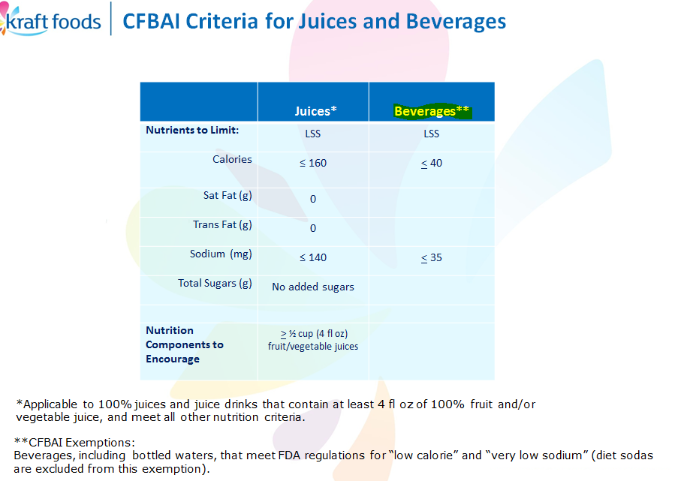
CFBAI Criteria for Advertising to Children
*Source: NAR and Corporate Affairs

Slide 32
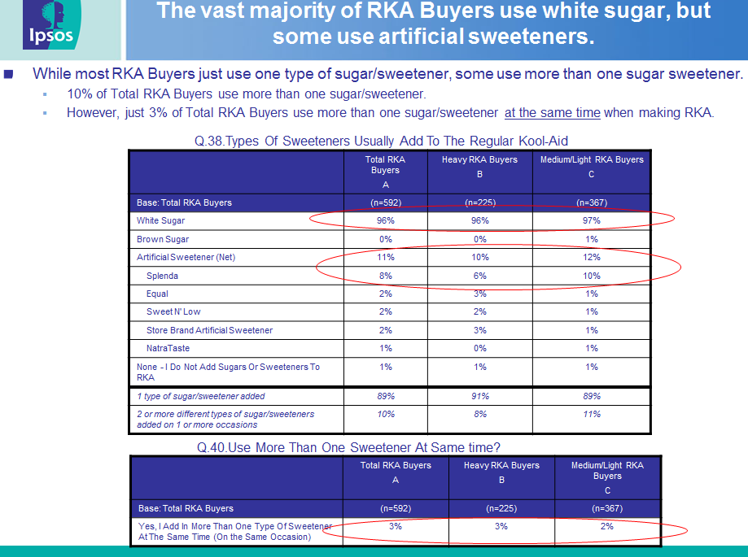

Slide 33
Different types of consumer testing are necessary to confirm taste acceptance and true impact on purchase intent
1st Hurdle: Can’t tell a difference Fixed cost
-e.g. Triangle Test Time: 3 – 4 weeks
2nd Hurdle: If a difference is noted Cost: $60-70k per product
-e.g. HUT Time: 8 weeks
… assess preference to minimize risk of alienation
For lower risk situations or smaller product lines Cost: $30k per product
. . . Consider CLT instead of HUT and Time: 4 - 5 weeks
smaller sample sizes
Internal Sensory Test
Larger Scale Acceptance Testing
Rigor/confidence ->
Smaller Scale Acceptance Testing
Costs are estimated figures, and type of tests actually needed may change after initial internal testing
Notes:
Consumer Testing needs to be done to confirm taste reassurance and no alienation of our core
Andrea Golightly –
-better slide representing brand health metrics and intent to purchase
BASES Re-stager would measure current messaging and current product; then test a different set of people on the new messaging/new product; then see whether the behavioral (intent to purchase) and attitudinal (brand associations) increased due to the new bundle
The lift comes from the communication of it, the idea of it. Not from the taste
-1st hurdle: Can’t tell a difference. (b/c if you can’t tell a diff. you can’t have a preference)
-internal sensory panel or internal discr. Testing (such as a Triangle test)
-if a diff. is noted, then -> acceptance testing with consumers (where we incur a cost) to minimize risk of alienation Cost: $60-70k; 8 wks for the test on top of developing, producing, and aging it.
Side note: no BASES re-stager being done on Jammers; saw the significant lift and so we did a snapshot and are doing a product fulfillment. BASES stuff takes a long time and costs a lot.
-is there a way we can do consumer testing of all of these changes simultaneously or some sort of batch testing?
>the only real parallel here is potentially testing Jammers and applying it to RTD bottles
-how much does it cost if we do something other than internal Triangle testing? It’s part of our Fixed cost
consumer taste reassurance (HUT is just a place) - HUTs take longer and cost more
CLT would cost about $30k (for lower risk situations like RTD bottles)

Slide 34
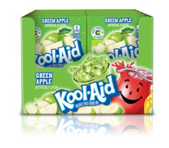
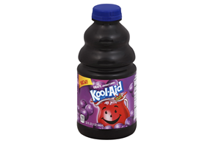

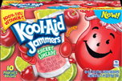

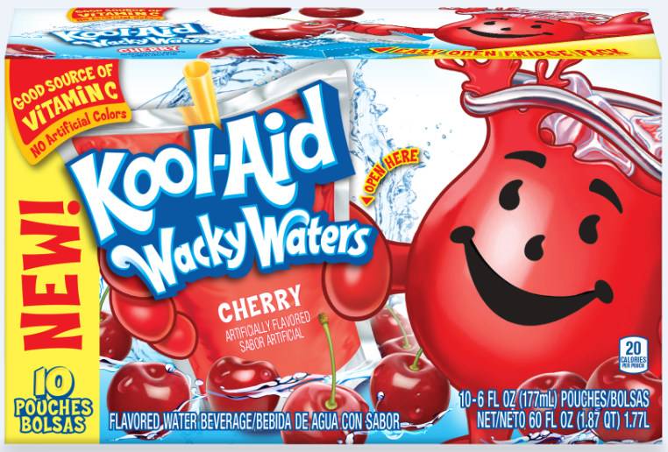
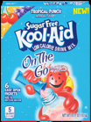
KA Portfolio nutrition contents by form
BMX
RTD
RKA
RTD 16, 32, 96 oz.
100 calories per serving according to primary prep instructions.
10% DV Vitamin C
150 cals and 38g of sugar/serv.
100% DV Vit. C
*16-oz is its own serving size. NOT targeted
to kids (target: millenial male)
SSKA
35% less sugar than l.r.s.
10% DV Vitamin C
Jammers
70 cals/serv. (pouch= 6-oz. serving)
100% Vit. C
Singles
50% less sugar than reg. KA
10% DV Vitamin C
Wacky Waters
Sugar-Free On the Go
80% less sugar than leading reg. sodas
No sugar
10% DV Vitamin C
Bursts
Easy Mix:
11g of sugar/serv.
No Vitamin C claim
LC:
0 calories; 0 sugar
No Vitamin C claim
75% less sugar than leading reg. sodas
No Vit. C
Notes:
Explore better way to represent this info; chart/timeline with a can of soda on a far end
Our user base is dwindling anyway; if we do nothing it’s going to continue to dwindle away. But being able to break barriers and convert non-users is high potential for us.
Try to tighten these up into one slide

Slide 35
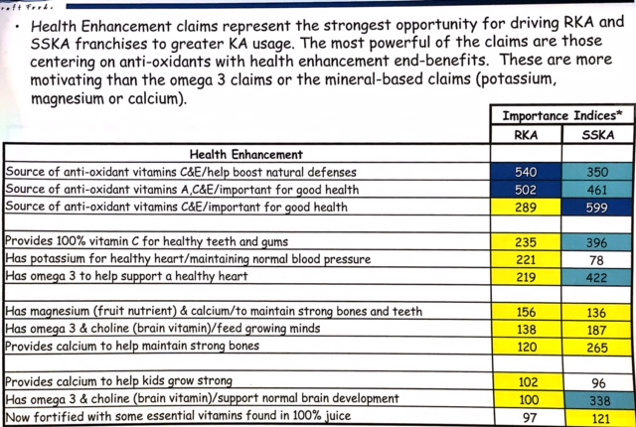
Claims Optimization Research showing Indices of Health Enhancement options including Vitamin C (doesn’t need to be 100%, just a source of)

Slide 36
Repositioned ‘low sugar’ communication increases perception of uniqueness and repeat purchasing
FINANCIAL POTENTIAL |  | Kool Aid Jammers Medium/Heavy BuyerS |  |  | Kool Aid Jammers Light/Non-Buyers
 |  | Kool Aid Jammers (Old Current) | Kool Aid Jammers (Restage) | Index vs. Current | Kool Aid Jammers (Old Current) | Kool Aid Jammers (Restage) | Index vs. Current
 | (Total Consumers) | (148) | (153) |  | (201) | (201)
 |  | A | B |  | C | D
 | OVERALL PURCHASE INTENT (%) |  |  | 97 |  |  | 96
 | Definitely Would Buy | 77 | 71 |  | 20 | 16
 | Probably Would Buy | 20 | 29^{A} |  | 14 | 21
 | Definitely or Probably Would Buy | 97 | 100^{A} |  | 34 | 37
 | Uniqueness | 2.9 | 3.8^{A} | 132 | 2.2 | 2.5^{C} | 114
 | Need/Desire | 4.5 | 4.7^{A} | 105 | 2.8 | 2.8 | 101
 | Advantage | 4.2 | 4.5^{A} | 107 | 3.4 | 3.5 | 104
 | Credibility | 4.7 | 4.6 | 99 | 4.2 | 4.1 | 97
 | Acceptable Costs | 4.5 | 4.7^{A} | 104 | 3.8 | 3.8 | 100
 | (Favorable Consumers) | (144) | (153) |  | (68) | (75)
 | Claimed Trial Units | 2.3 | 3.2^{A} | 136 | 1.7 | 1.8 | 110
 | Claimed Annual Purchase Frequency | 27.3 | 34.7^{A} | 127 | 21.1 | 16.3 | 77
 | Relaunch Potential Score (RPS) | 101
The “Old Current” concept over-communicated Jammers’ benefits and thus underestimated the restage potential. A “New Current” concept was assessed to yield an RPS of 103.
*Source: KA Jammers Restage Topline report

Slide 37
NAR & Legal Guidelines for Compliance
Serving Sizes
*Source: KraftHeinz website, Corporate Affairs
* Serving sizes are calculated based on multiples of the Reference Amount Customarily Consumed (RACC) (US) for each food type. If your package contains between 200% and 400% of the RACC/RA, then you must determine if it falls into category (2) or category (3). To check RACC amounts for your product, contact your Regulatory representative.
“Good”
10-19% DV
per serving and RACC
“Excellent”
20% + DV
per serving and RACC
Absolute
100% DV
per serving and RACC
FDA Definitions – Good Source, Excellent Source, Total
*Claims must be met at the end of product shelf life*

Slide 38
List of considerations as defined by Corporate Affairs in GENERAL PRINCIPLES FOR THE ADDITION OF OR CHANGE IN NUTRIENTS TO FOODS, 2012
“APPENDIX II: QUESTIONS TO CONSIDER FOR NUTRIENT ADDITION”
2. Nutrients that may deliver a health or wellness and/or functional benefit:
a. What is/are the proposed nutrient(s)/ingredient(s)?
b. What level is proposed for addition? What level is naturally occurring in the food? What level of addition is scientifically accepted to for a claimable benefit?
c. Is the nutrient deficient, inadequate or a public health concern in the intended population?
d. Have tolerable upper limits been established for the nutrient and, if so, does the intended level of the consumption in the diet, which would include the consumption of our product, result in approaching the upper level?
e. Is the proposed level considered safe not only for the targeted population but also for other subpopulations and vulnerable populations?
f. How strong is the scientific support for the role of the nutrient(s)/ingredient(s) in delivering a specific health or wellness and/or functional benefit?
g. What form of the nutrient is proposed for addition and is that form bioavailable?
h. Will the nutrient be stable in the food during processing?
i. Will the nutrient be stable in the food over shelf life?
j. Is the overage, i.e., the level of nutrient added to ensure sufficient level to maintain the claim is present over shelf life, considered in your calculation?
k. Are there any interactions between the nutrient and other nutrients in the food when on the shelf or when prepared?
l. Is there evidence to suggest that adding the particular nutrient(s) to the food would benefit the population consuming the product?
m. Is the proposed level considered safe for the population?
Notes:
All of these questions were taken into consideration in making my recommendation

Slide 39
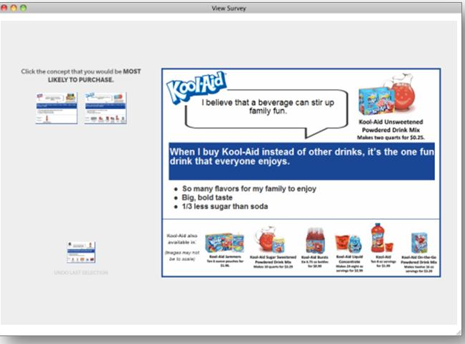
Affinova Methodology, Tested Concepts and Conclusions
3 Top Concepts (TCs) optimize:
  Preference is shown for health/wellness RTBs (35% less sugar than soda, Vitamin C), flavor variety mentions, Unsweetened Mix Hero’d product (secondarily Jammers in one TC)
As tested, a Kool-Aid restage generates significant preference lifts over current, with TC 1 (Value+ Sugar Control), TC 2 (Childhood Memories) and Pre-Optimized Concept Optimal Sugar Control garnering the strongest lift over current (+ ~54%).
  Consumers specifically praise and focus on the health and wellness RTBs (less sugar/ability to control and presence of vitamin C) and the availability of a variety of flavors and affordable products for all occasions.
Outside the context of the holistic concept, consumers indicate strong interest in the 35% less sugar & Vitamin C RTBs which are present in all three Top Concepts, indicating strong consumer reassurance and acceptance of these RTBs.
Governing question
Paired concept interface
shows consumers only two concepts at a time; upon selection, next concept in line moves up until final selection is made
Focus window
displays full size concepts when consumer mouses over each thumbnail

Slide 40
LC Vitamin C Fortification Test Results Tracker
(as of 5.4.15)
*Source: Mio Base Renovation deck, May 2015.
 | Up Front Criteria to Test |  | Shelf Life Study (12wk accelerated) |  | Analytic Study (vitamin degradation results) |  |  | Study
SKU | PG Free | Not Sold in Canada/Mexico or 2 Batch Min Run | Taste | Appearance | 10% B & 10% C | 10% C | 10% B | Sensory/ CLT
Lemonade | Pass | Pass | Pass | Pass | Marginal Miss (5% miss) | Marginal Miss (5% miss) | Pass | Pending
Fruit Punch | Pass (10/22) | Pass | Pass | Pass | Miss (40% miss) | Miss (40% miss) | Pass
Sweet Tea | Pass (10/22) | Pass | Pass | Fail (@8wks) | Marginal Miss (5% miss) | Marginal Miss (5% miss) | Pass
Berry Pom. | Pass (10/22) | Pass | Fail (@8wks) | Fail (@12wks) | Miss (25% miss) | Miss (25% miss) | Pass
Orange Tang. | Pass | Pass | Pass | Fail (@12wks) | Miss (40% miss) | Miss (40% miss) | N/A
Crisp Apple | Pass | Pass | Not Yet Tested
Berry Grape | Pass | Pass | Not Yet Tested
Orange Vanilla | Pass | Pass | Not Yet Tested
Notes:
We’re missing in all of these SKUs. Second round of testing coming up. Sweet Tea is missing AND seeing discoloration

Slide 41
R&D Mio fortification project schedule (tentative)
Launch timing for MiO with Vitamin C is March of 2016.
R&D will likely do plant trial/start up/saleable product run (all in one) in Feb 2016.
Date Begin | Date End | Component
5/15/15* | 8/15/15 | Accelerated Shelf-Life Testing
6/15/15 | 8/21/15 | R&D/Marketing Team Tasting (Weeks 4, 8, and 12)
8/15/15 | 9/7/15 | Analytical Testing and Team Tasting (Weeks 4, 8, and 12)
9/7/15 | 9/10/15 | Team Decision on Final Formula
10/2/15 | 10/2/15 | PLR Ready
N/A | ~ March 2016 | Trade Release
*Source: Deepa Raju, R&D

Slide 42
Cost Implications (Mio/LC fortification project)
Variant | Diff vs. PG-Free Control
PG-Free | N/A
10% B-Vitamin | 1%
10% Vitamin C | 0.5%
10% B-Vitamin and 10% Vitamin C | 2%
*Source: Mio Base Renovation Recommendation 5/4/15
RKA basket analysis – sweeteners
RKA SBA
Category |  | Cross Brand | Cross Brand % of All Baskets | Common Baskets / Focus Brand Trips | Index to Overall
3801 | SUGAR - GRANULATED | Private Label | 0.72% | 22.00% | 3,044
3801 | SUGAR - GRANULATED | DIXIE CRYSTALS | 0.03% | 0.57% | 1,915
3801 | SUGAR - GRANULATED | C & H | 0.13% | 1.57% | 1,225
3801 | SUGAR - GRANULATED | DOMINO | 0.18% | 2.03% | 1,107
1102 | DIET SWEETENERS | Private Label | 0.11% | 0.57% | 535
3802 | SUGAR - BROWN/POWDERED/FLAVRD | Private Label | 0.24% | 0.84% | 355
Notes:
Per marginal (end-result) 10% of vitamin c -> 0.5% cost increase (raw materials). Manufacturing is internal for LC super-concentrate

